Slide 1

by: Lek Tiek Leong / 13 Aug 2022
GA DSI Project 3
Web APIs and NLP

Slide 2
Contents
Problem Statement
Data used and Feature selection
Data cleaning
Preprocessing and EDA
Models Building and Evaluation
Results Analysis
Conclusion and Recommendations
Q & A

Slide 3


Problem Statement
​​
To create a text classification model to determine whether a reddit post belongs to either one of these two subreddits:
r/depression
r/bipolarreddit

Slide 4
Data used and Feature selection
1,000 posts per subreddit
Joined selftext and title as Feature
subreddit as Target
0 ⇒ depression
1 ⇒ bipolar

Slide 5
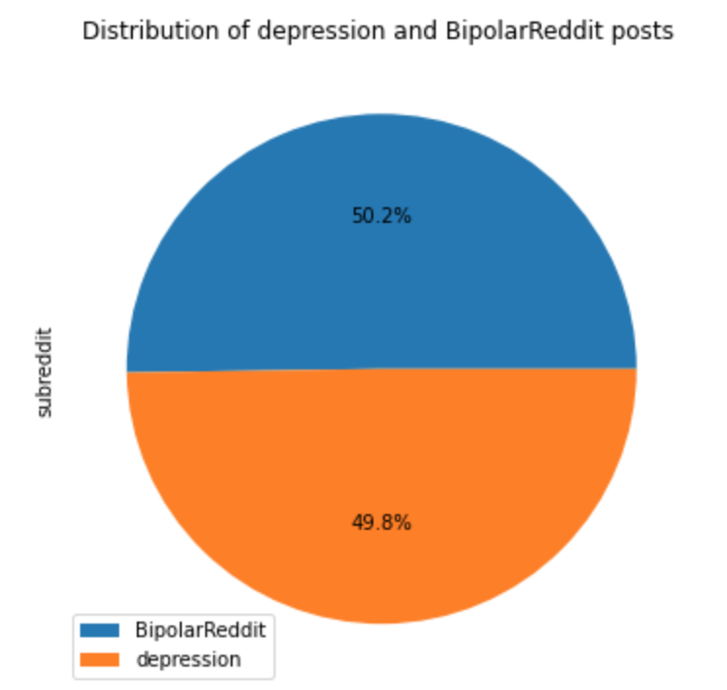
Data cleaning
Remove duplicates
Replace missing values with empty string value('')
Replace “[removed]” tags with empty string value('')
After cleaning, 1981 posts left.

Slide 6
Preprocessing and EDA
Tokenize text
Change text to lowercase
Remove special characters
Remove stopwords
POS Tagging (Adj, Noun, Verb, Adv)
Lemmatizing

Slide 7
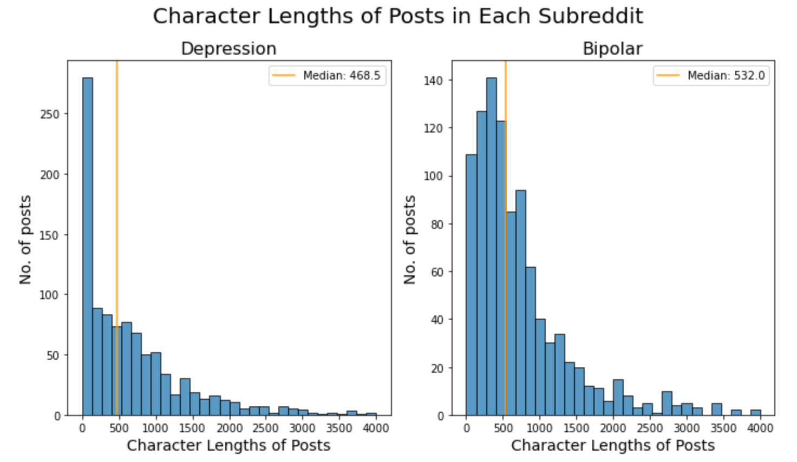

Slide 8
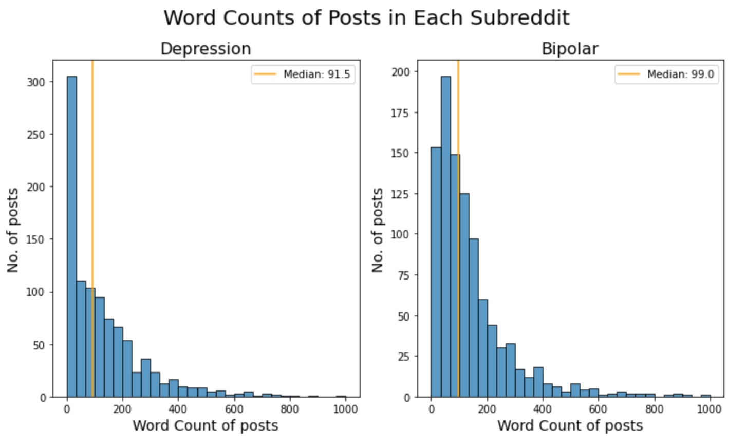

Slide 9
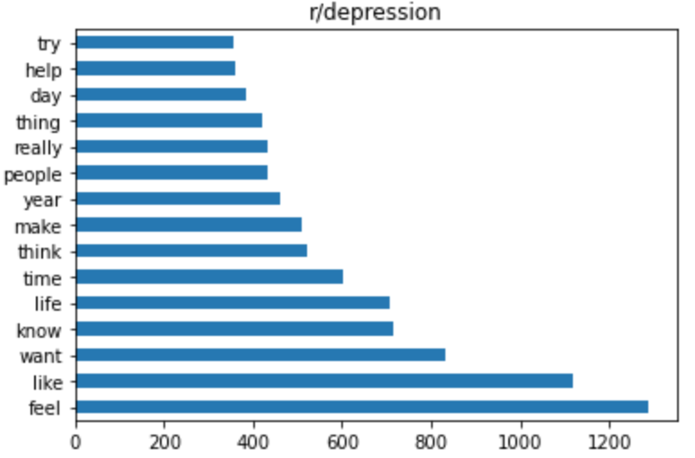
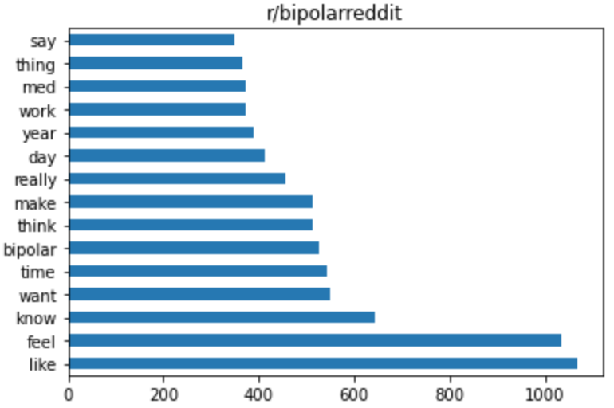
Top 15 most occurring words

Slide 10
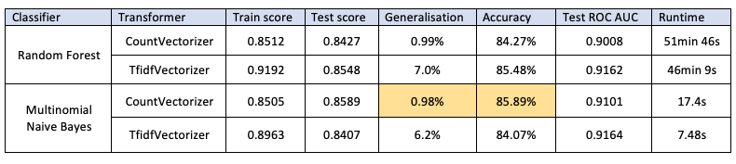
Models Building and Evaluation
Null accuracy = 0.5020
Train size = 75%
Test size = 25%
Hyperparameters tuning: Pipeline and Gridsearch

Slide 11
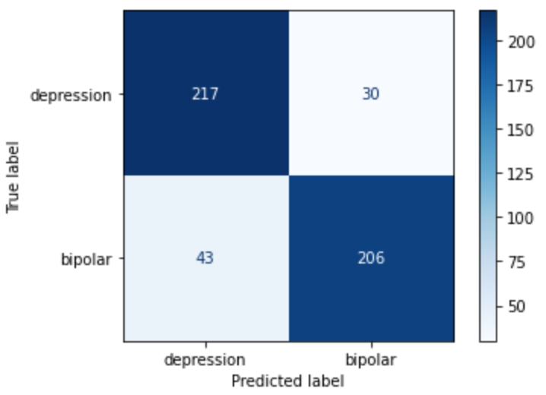
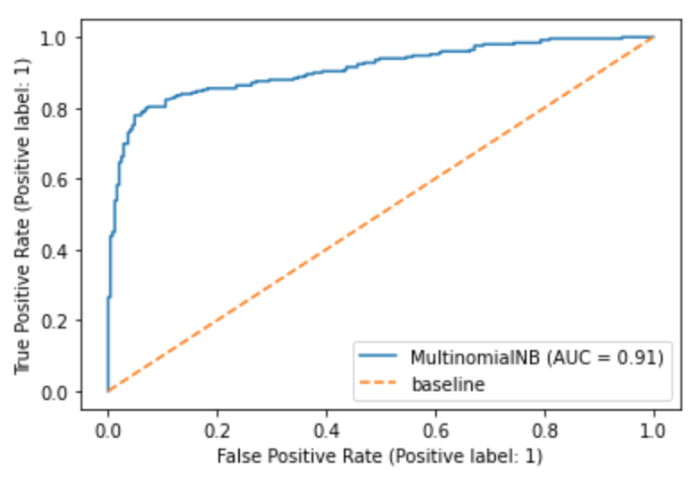
Results Analysis
Final Model: Multinomial Naive Bayes with CountVectorizer
Reason: Lowest generalisation of 0.98%, Highest accuracy of 85.89%, Test ROC AUC score of 0.91 and fast runtime of 17.4 seconds.
Best parameters:
ngram_range : (1, 2),
max_df : 0.9,
min_df : 3,
max_features : 1000

Slide 12
Conclusion and Recommendations
Final model Multinomial Naive Bayes is performing fairly well in predicting subreddit posts with an accuracy of 85.89%.
Model is affected by the misclassification of posts already in the subreddits.
To collect beyond 1000 posts so as to minimize the ratio of default misclassified posts, and improve model’s performance.
Use word similarities (e.g. word2vec) to classify posts.
Use topic modelling to first extract topics from words before classifying e.g. LDA
Explore other classification models e.g. SVM
Explore relationship between post content, number of comments, and upvote ratio.

Slide 13
Q & A

